Slide 1

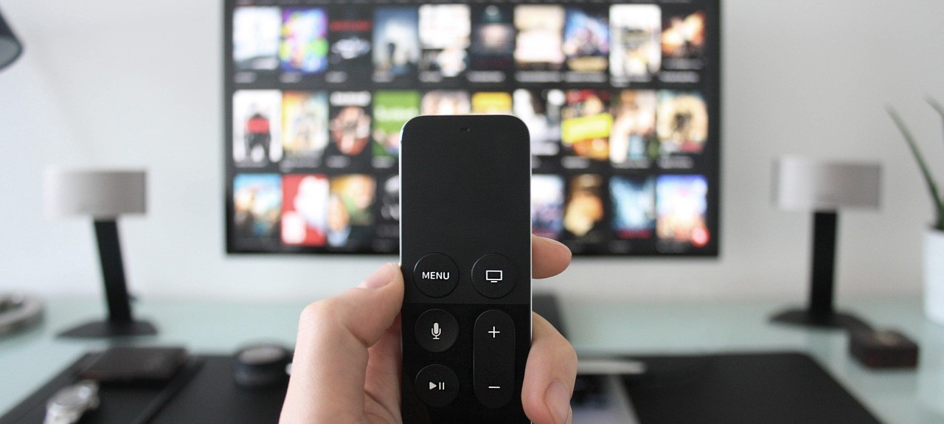
October 2018
Viewing Trends Overview

Slide 2

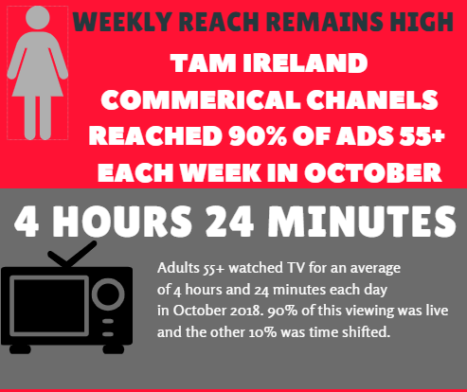
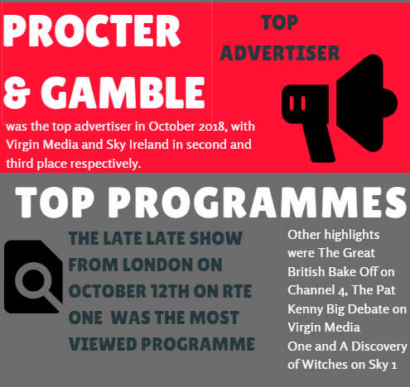
Total Viewing-October 2018

Slide 3
Average Minutes viewed daily
October 2018
85% of an Adult 15-24 viewing is to live TV, with the other 15% of viewing time-shifted

Slide 4
TV Viewing: Live v Time shift %
90% of the minutes viewed by Adults 55+ are to LIVE TV.
Source: TAM Ireland Ltd / Nielsen TAM / Av mins, Total TV, Consolidated, National

Slide 5
Weekly reach of TAM Ireland Commercial Channels

Slide 6
Commercial Impacts October 2018

Slide 7
Top 10 Advertisers October 2018
1: Procter & Gamble
2: Virgin Media
3: Sky Ireland
4: Vodafone Ireland
05: Three
10: Eir
07: Reckitt Benckiser
08: McDonalds
09: Tesco Ireland
06: Diageo

Slide 8
Top Programmes October 2018
Top 5 programmes by station group are below. A breakdown of the Top 10 programmes by station for October 2018 can be found here
Late Late Show, London
Coronation Street
Live Renault Super Sunday Liverpool V Man City
RTE News: Nine O'clock
Late Late Show, The
Reeling In The Years
Prime Time - The Presidential Debate
Pat Kenny Big Debate
Emmerdale
The Xfactor
Googlebox Ireland
Live MNF: Spurs V Man City
Live UEFA Nations League: ROI V Wales
A League of Their Own
A Discovery of Witches

Slide 9
Top Programmes October 2018
Top 5 programmes by station group are below. A breakdown of the Top 10 programmes by station for October 2018 can be found here
The Great British Bake Off
GAA BEO 2018 - 2019
GUINNESS PRO14 2018/19
Ben & Hollys Little Kingdow
Gogglebox
Gogglebox: Celebrity Special SU2C 2018
Carpool Karoke: Michael Bublé Part 2
More Celebrity Gogglebox:
Geordie Shore
Friends
Teen Mom UK
Impractical Jokers
Hector Ó Siberia go Saigon
Rugbaí Beo Pro 14 2018-2019
Opry le Daniel
Reservoir Dogs
AIB GAA Club Championship
International Football
Feherty 2018
2018 European Darts Championship

Slide 10
Audience Affinity (Indexes) October 2018
Indexes are very helpful when targeting specific audience groups. They show the likelihood that your target audience will watch a specific programme compared to the average (base) audience (we use “Adults 15+” as the base audience in calculating these figures). Below are the top 3 programmes on Irish TV that deliver a higher than average percentage of the chosen audience for HW+CH, Ads 15-24, Ads15-34, Ads 25-44 and Ads ABC1. The top 30 programmes for each audience can be found here
Adults 15-34
Programme Station Index
BOB'S BURGERS Comedy Central Extra 374
Adults 15-24
Programme Station Index
FRIENDS Comedy Central Extra 804
IMPRACTICAL JOKERS Comedy Central 347
AN IDIOT ABROAD S2 Sky 1 259
WIPEOUT USA Comedy Central Extra 804
MALCOLM IN THE MIDDLE Comedy Central Extra 683
Indexes are very helpful when targeting specific audience groups. They show the likelihood that your target audience will watch a specific programme compared to the average (base) audience (we use “Adults 15+” as the base audience in calculating these figures). Below are the top 3 programmes on Irish TV that deliver a higher than average percentage of the chosen audience for HW+CH, Ads 15-24, Ads15-34, Ads 25-44 and Ads ABC1. The top 30 programmes for each audience can be found

Slide 11
Audience Affinity (Indexes) October 2018
HW+CH
Programme Station Index
COME DINE WITH ME More4 671
FOUR IN A BED More4 564
Adults ABC1
Programme Station Index
LOCATION, LOCATION, LOCATION Channel 4 Ireland 275
Adults 25-44
Programme Station Index
IMPRACTICAL JOKERS: INSIDE JOKES Comedy Central 336
TEEN MOM OG MTV 547
GRAND DESIGNS Channel 4 Ireland 249
OLD PEOPLE'S HOME FOR 4 YEAR OLDS Channel 4 Ireland 246
THE CIRCLE UNCOVERED Channel 4 Ireland 325
IMPRACTICAL JOKERS Comedy Central 309

